Slide 1
Bio& 241 A&P 1 Unit 2 / Lecture 3

Slide 2
Functional classification of joints (based on degree of movement permitted within the joint)
Synarthrosis: Immovable joints
a) Sutures = joint between bones in the skull.
b) Synchondrosis = epiphyseal plate.
(Hyaline cartilage is eventually replaced by bone).
c) Synostosis = epiphyseal line of mature bones.
Amphiarthrosis: Slightly movable joints
a) Syndesmosis = dense fibrous connective tissue located
on the distal or proximal portion of long bones.
(eg. distal tibia and fibula, also distal radius and ulna)
b) Symphysis = cartilaginous joint (fibrocartilage).
(eg. pubic symphysis and intervertebral discs)

Slide 3
Functional classification of joints (based on degree of movement permitted within the joint)
Diarthrosis: Freely movable joints
c) synovial joints:
have a space between the bones called a synovial joint cavity, containing synovial fluid. The joint also has articular cartilage.

Slide 4
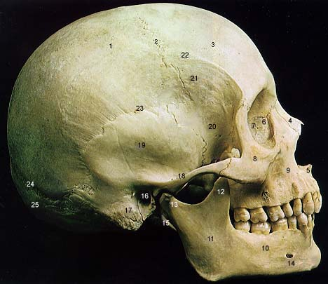
Synarthrosis: immovable joints
Suture

Slide 5
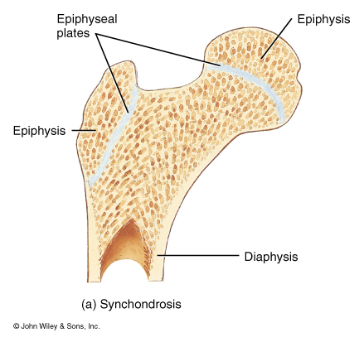
Synarthrosis: immovable joints
Synchondrosis

Slide 6
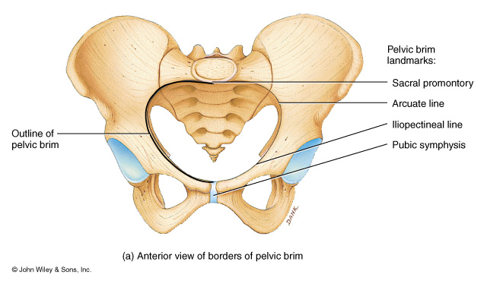
Amphiarthrosis: Slightly movable joints
Symphysis

Slide 7
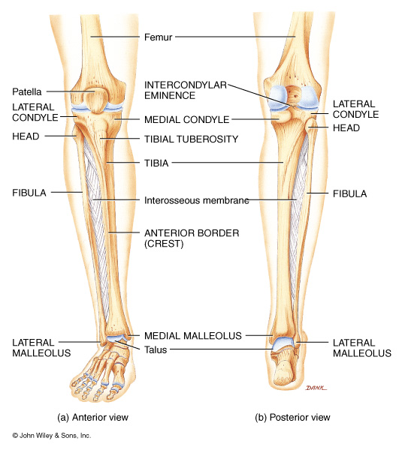
Amphiarthrosis: Slightly movable joints
Syndesmosis

Slide 8
Synarthrosis or Amphiarthrosis?
Gomphosis

Slide 9
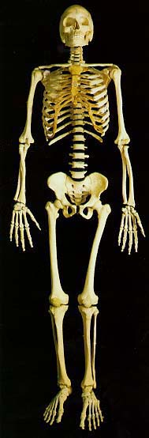
Diarthrosis: freely movable joints

Slide 10
Structural classification of joints (based on the presence or lack of a joint cavity and fibrous connective tissue)
Fibrous Joints
NO joint cavity. Fibrous CT hold bones together.
Cartilaginous Joints
NO joint cavity. Cartilage connects bones together
Synovial Joints
HAVE a joint cavity, containing synovial fluid, and ligaments which provide extra support. Cartilage is also present.

Slide 11
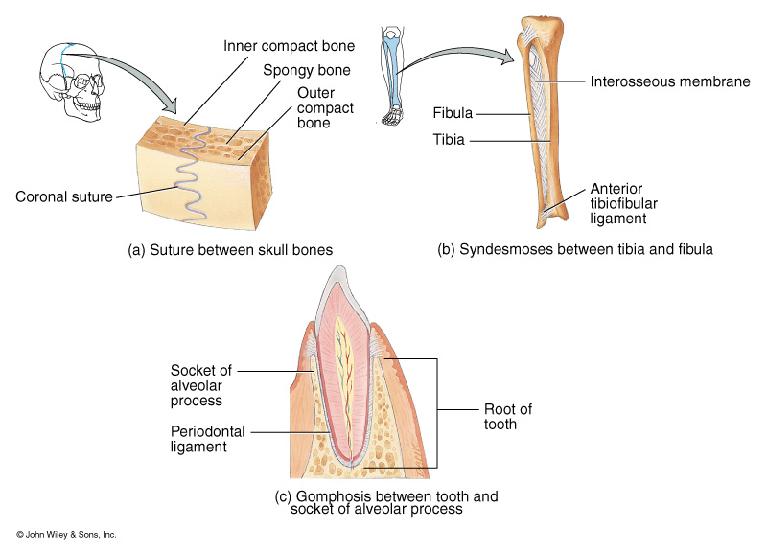
Fibrous joints

Slide 12
Cartilaginous Joints
Synchondroses: Epiphyseal plate
First Rib and Manubrium
Symphyses: Pubic symphysis

Slide 13
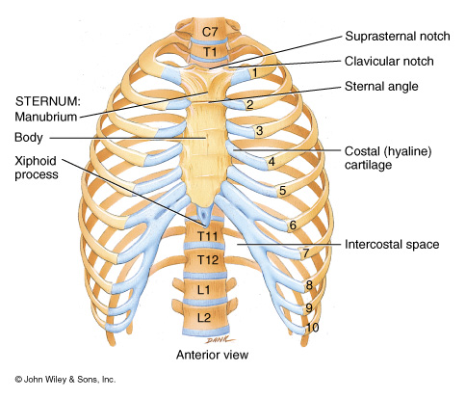
Synchondrosis

Slide 14
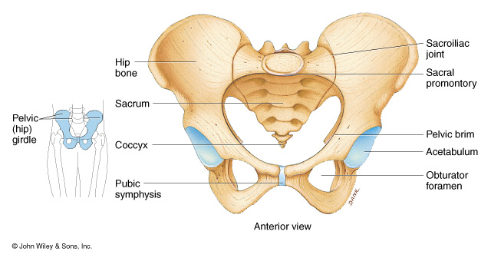
Symphysis

Slide 15
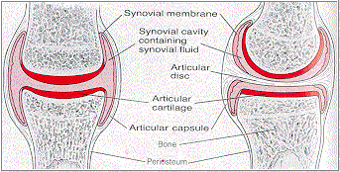
Synovial Joints

Slide 16
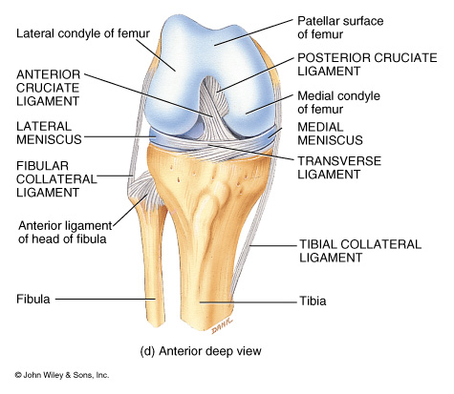
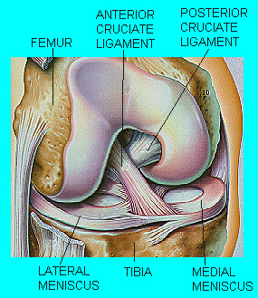
70% of knee injuries involve stretching or tearing the ACL

Slide 17
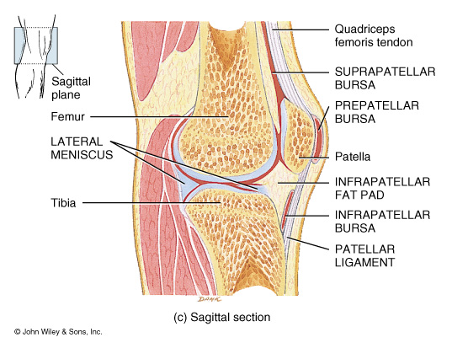

Slide 19
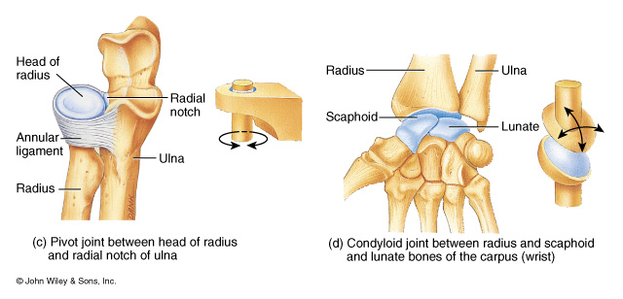

Slide 20
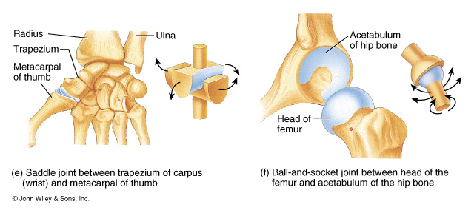

Slide 21
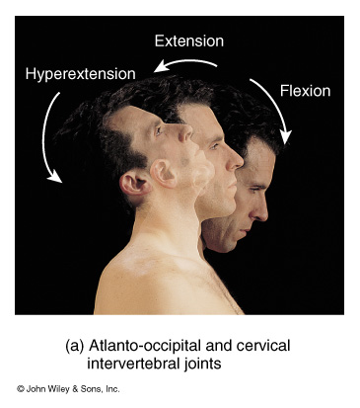
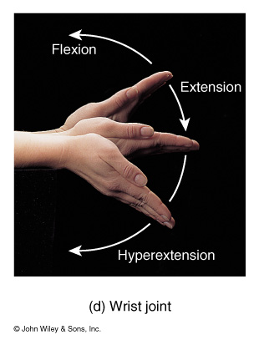

Slide 22
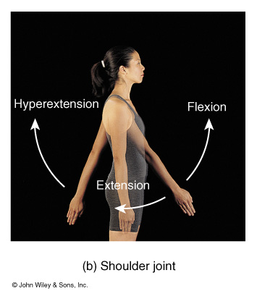
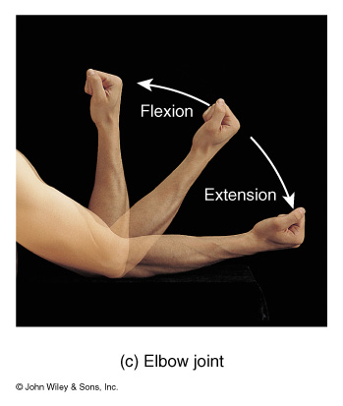

Slide 23
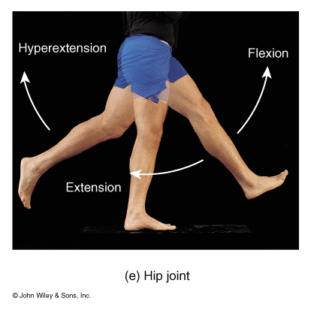
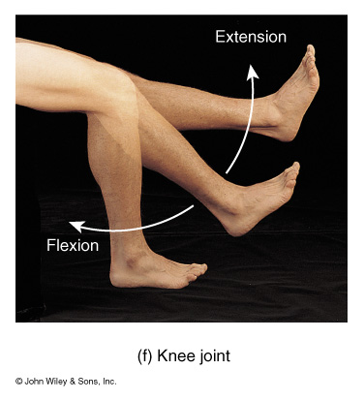

Slide 24
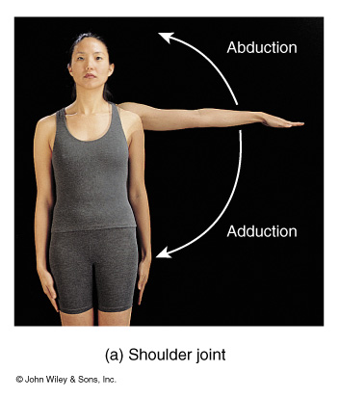
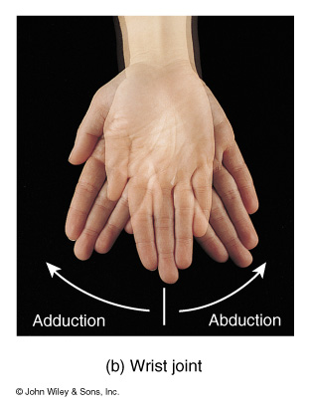

Slide 25
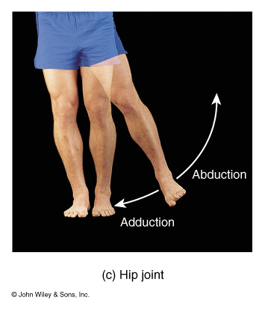
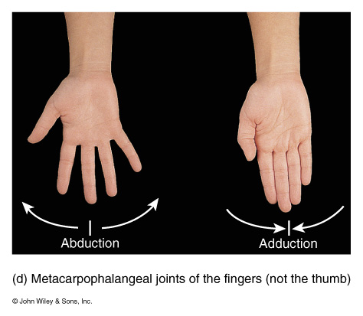

Slide 26
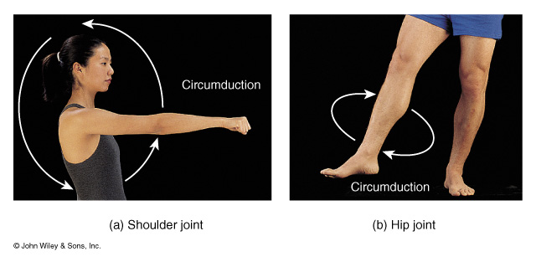

Slide 27
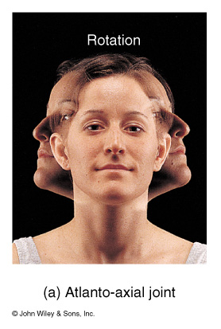
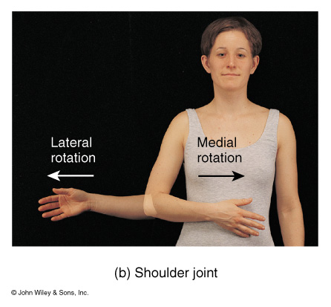

Slide 28
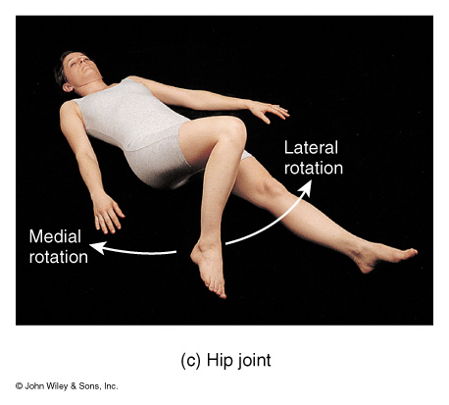

Slide 29
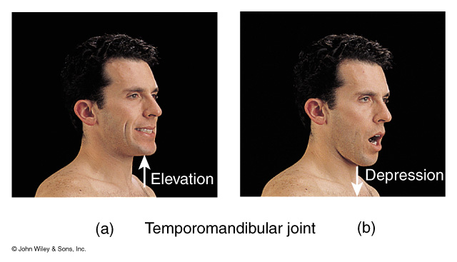
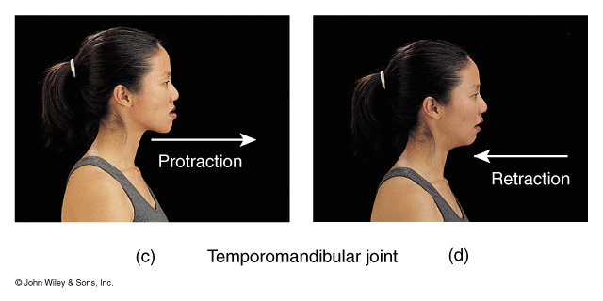

Slide 30
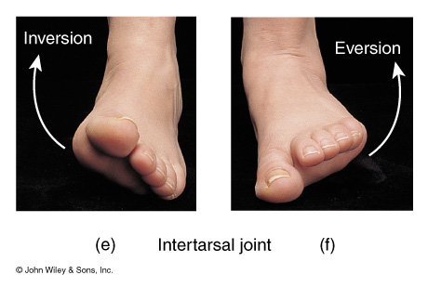
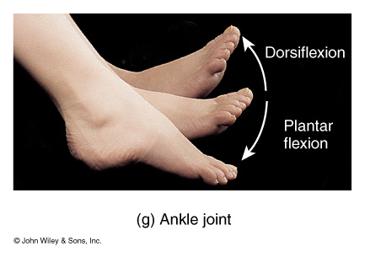

Slide 31
